Slide 1
FLS Unit 11
Johnny Vogt

Slide 2
Quick Quiz Questions
B
C

Slide 3
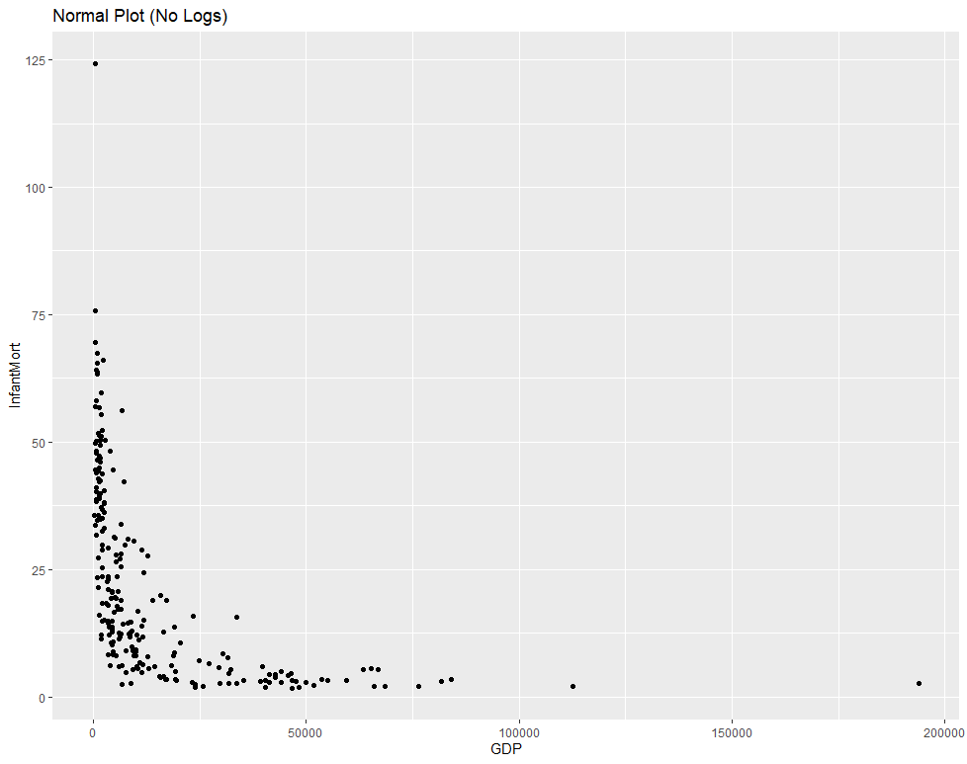
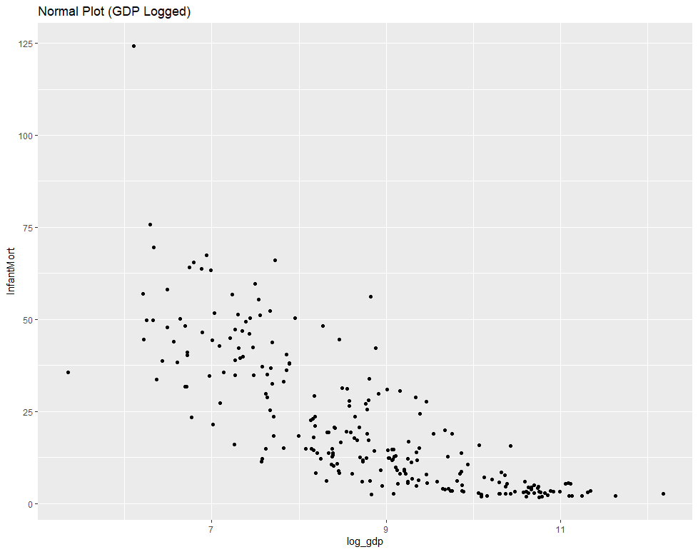
GDP vs. Infant Mortality Scatterplots
No Logs, Had a L shaped pattern, no linearity, no homoscedasticity and Outliers
Logging the X variables, seems to normalize the data alot more and makes the data alot more “linear”, although each subset of X do not seem to have the same variance.

Slide 4
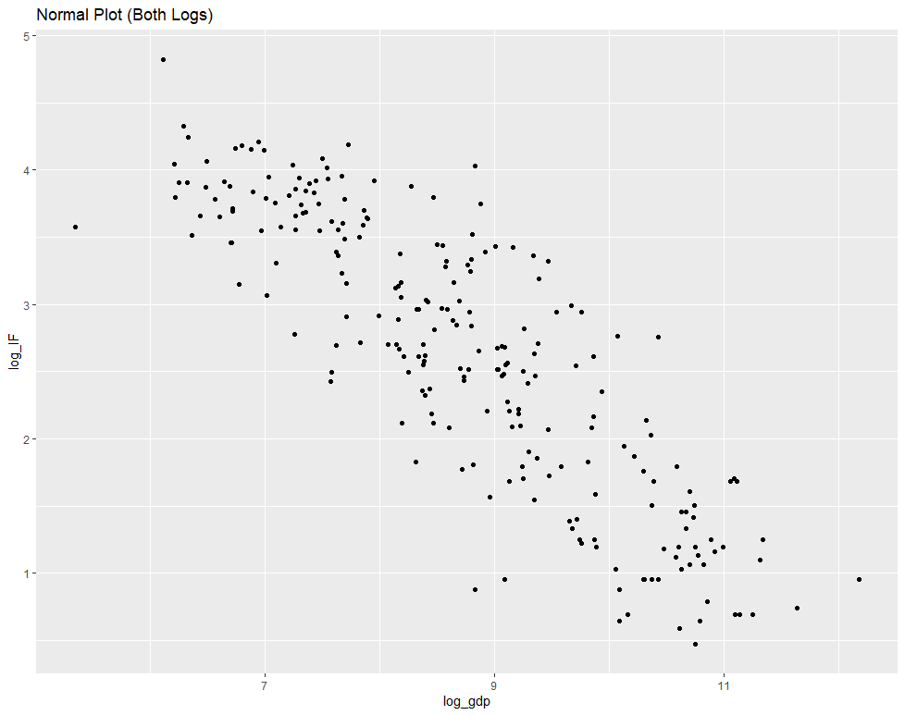
GDP vs. Infant Mortality (Just right)
The data seems to fit all the assumptions through a visual check. It’s linear, the data seems to be normal and that each subset of X has the same approximate variance.

Slide 5

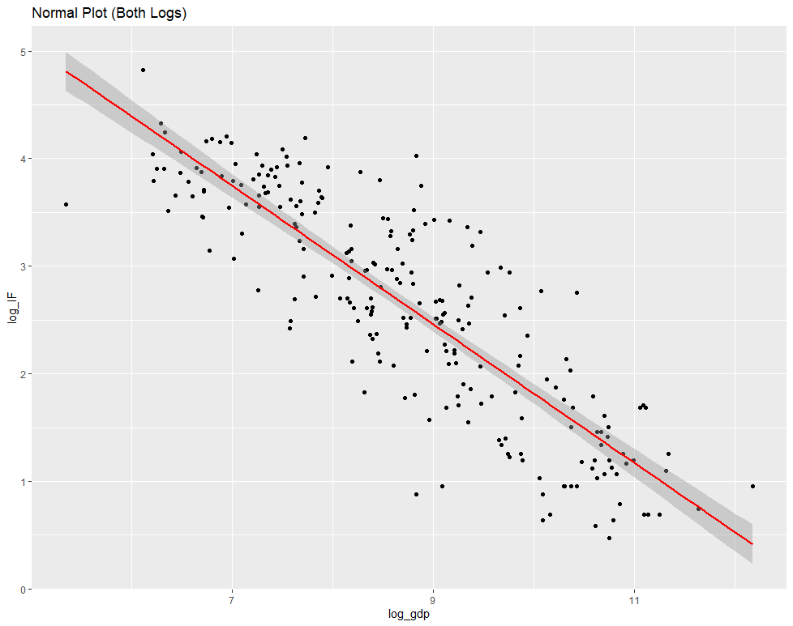

Regression Line
Looks like it meets all the assumptions
Looking at the US data, it looks like the logged data at 11.08 GDP and 1.78 IF Rate is ABOVE the regression line.
Regression Equation
log(InfantMort) = 8.257 -0.644log(GDP)
The Infant Mortality drops proportionally, at a 10% increase of GDP, the Infant Mortality has an associated decrease of 6.44%.

Slide 6
Lack of Fit Test
Source | df | SS | MS | F | Pr > F
₁₃ | 124.731
Source | df | SS | MS | F | Pr> F
Model | 1 | 26.5673441 | 26.5673441 | 3.2477062559 | 0.097
Error | 12 | 98.16409 | 8.18034083
Total | 13 | 124.7314341

Slide 7
Takeaway
I’m back home, and finally can study and spend time on everything
The Manual ANOVA Table was a nice throwback
Was definitely confused by some of the slides having parts of the definition cut out
FINALLY LOGS, haha

